Slide 1
Does Robustness on ImageNet Transfer to Downstream Tasks
CVPR 2022
鄧仲恩
NTUST GAMELab

Slide 2
Outline
Introduction
Background
Fixed-Feature Transfer Learning
Full-Network Transfer Learning
Do Larger Models Transfer Robustness Better?
Adversarially-trained Networks do not Transfer Robustness to Downstream Tasks
Related Works and Discussions
Conclusions
NTUST GAMELab

Slide 3
Introduction
NTUST GAMELab

Slide 4
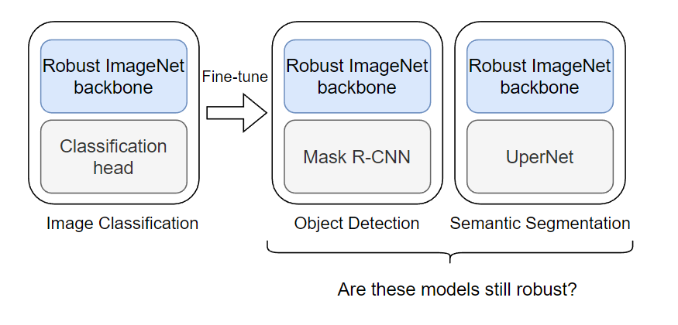
Introduction
ImageNet serves as an important benchmark in the field of computer vision.
A lot of natural noises can significantly degrade the performance of models. ->blur, contrast change, and snow
Data augmentation can increase robustness. ->ANT、AugMix、DeepAug+
There are now a variety of ImageNet-scale robustness benchmark.
We use pretrained weights that are made to be robust to ImageNet benchmarks,
do these models necessarily show robustness for downstream tasks as well?
NTUST GAMELab
Notes:
ImageNet
對比

Slide 5
Introduction – Contribution
Freeze the backbone maintain robustness for downstream tasks.
Swin Transformer on dense prediction tasks better than CNN.
CNN seems difficult to transfer corruption robustness from ImageNet to CIFAR10.
NTUST GAMELab
Notes:
Robustness 破壞

Slide 6
Background
NTUST GAMELab

Slide 7
Background
Real-world applications
Approaches to ensure robustness for downstream task. a. Transfer learning b. Data augmentation
Vision Transformer for Dense Prediction Tasks CNN(Hierarchical) -> ViT(Low-resolution) -> Swin
Source of Robustness: Data augmentation and Architecture
NTUST GAMELab
Notes:
1.自駕車 易受干擾 不佳 classification -> ensure robustness -> downstream tasks
2.但是下游任務通常較為複雜 需融合更多的Data augmentation ，者也導致失去主幹的robust
4. Vanilla CNNs 易受圖片破壞干擾，即使是imagenet大型資料集上也如此

Slide 8
Fixed-Feature Transfer Learning
NTUST GAMELab

Slide 9
Fixed-Feature Transfer Learning
Pretrain on ImageNet-1k. CNN(ResNet50) ->ANT 、DeepAug+ Swin Transformer(Swin-T) -> without any robustification technique
Downstream task object detection -> Mask-RCNN -> COCO 2017 validation set -> AP semantic segmentation -> UperNet -> ADE20K -> mean IoU
NTUST GAMELab
Notes:
Why Fixed-Feature Transfer Learning
architecture vs. data augmentation

Slide 10

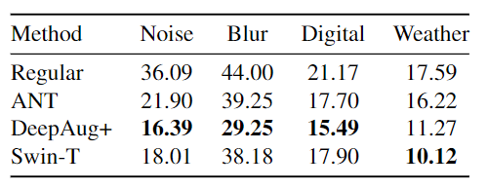
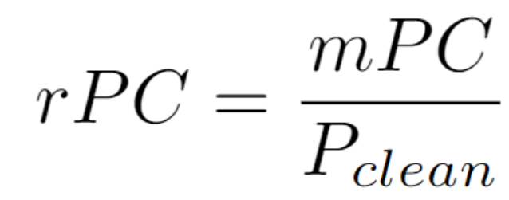
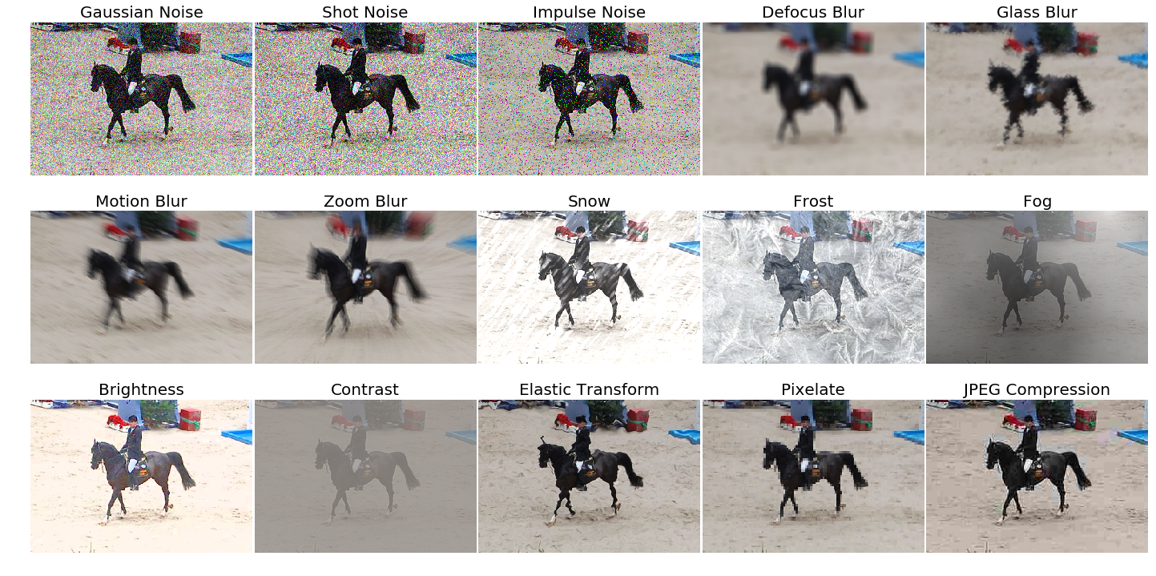
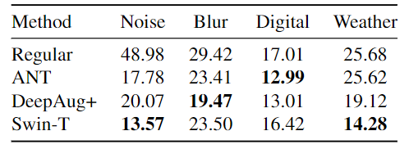
Fixed-Feature Transfer Learning
Detection
Segmentation
NTUST GAMELab
Notes:
deepAug與Ant確實有保持魯棒
Swin可媲美上兩個模型

Slide 11
Full-Network Transfer Learning
NTUST GAMELab

Slide 12
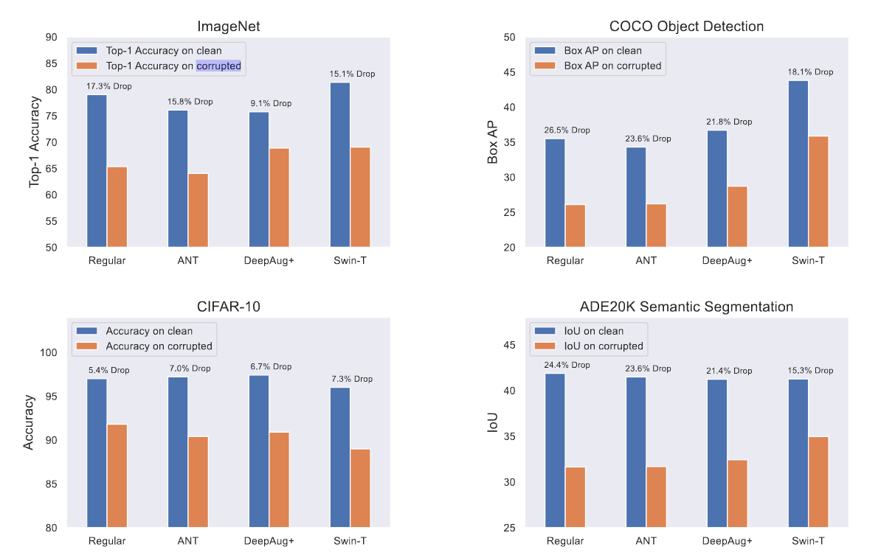
Full-Network Transfer Learning
NTUST GAMELab
Notes:
Transformer architectures might be more effective than CNNs
Swin-T high than other
downstream image classification seems to be harder to transfer than object detection and semantic segmentation.

Slide 13
Do Larger Models Transfer Robustness Better?
NTUST GAMELab

Slide 14
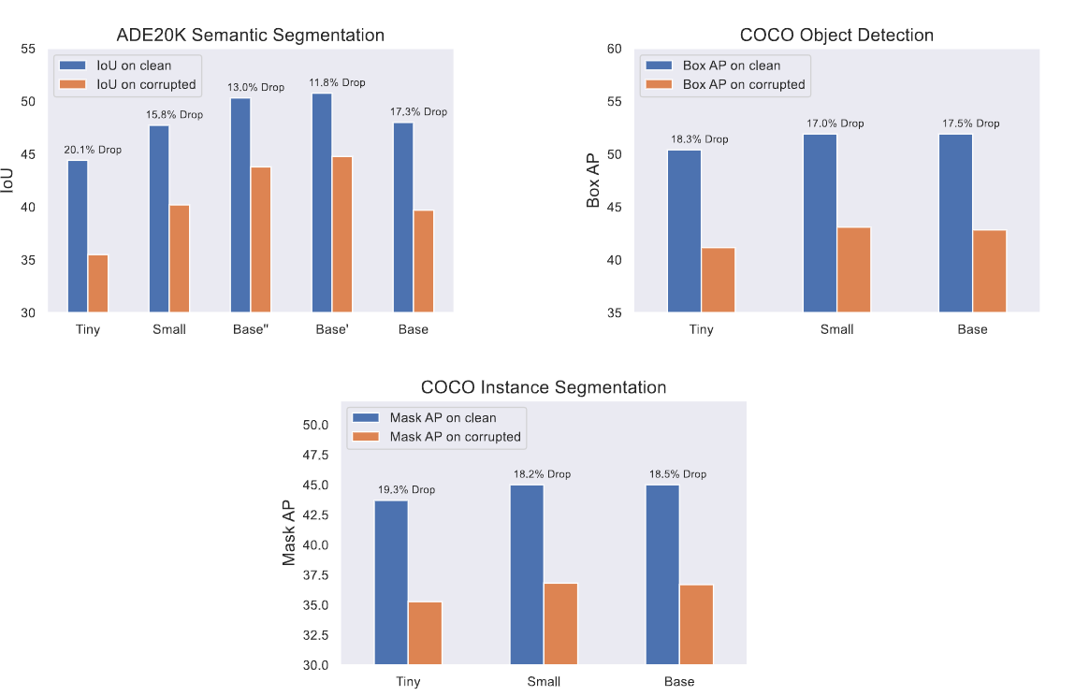
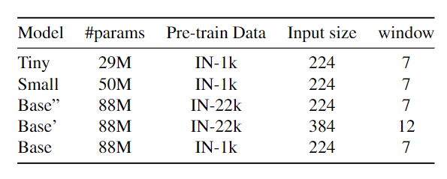
Do Larger Models Transfer Robustness Better?
NTUST GAMELab
Notes:
Down score SMALL< BASE

Slide 15
Adversarially-trained Networks do not Transfer Robustness to Downstream Tasks
NTUST GAMELab

Slide 16
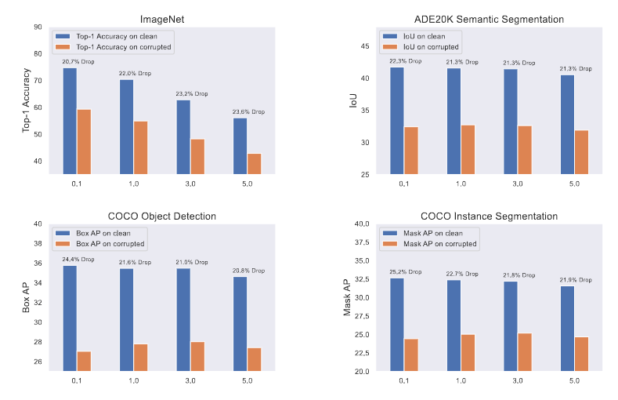
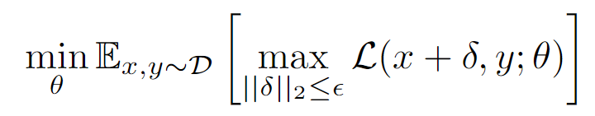
Adversarially-trained Networks do not Transfer Robustness to Downstream Tasks
robust optimization objective
NTUST GAMELab
Notes:
x 樣本 δ(Delta) 干擾訊號 S(epsilon)干擾訊號範圍 y label
最小化 最大的干擾樣本
先前研究 -> better in clear data
只有在resnet上實作
0.1最佳

Slide 17
Related Works and Discussions
NTUST GAMELab

Slide 18
Related Works and Discussions
Transfer learning to image classification tasks
Robustness of Vision Transformer
Robust object detection and segmentation Detection : adversarial、designed architectures segmentation : student-teacher architecture、increasing shape bias
Robustness Transfer
Overfitting to ImageNet
NTUST GAMELab
Notes:
1.Transfer learning good /bad in fine-grained classification datasets -> robustness and downsteam
2. larger Vision Transformers require data to be robust. -> 實驗之一
3. adversarial research/但Obj detect robust 在遮擋問題/designed architectures
seg/student-teacher architecture/increasing shape bias -> focus on using transfer learning to increase robust (robust transfer!!)
4.Old research focus increase robustness in classification / test on noise, blur, and weather change->same result
5. ImageNet所產生依賴資料 / video

Slide 19
Conclusions
NTUST GAMELab

Slide 20
Conclusions
fixed-feature transfer learning
full-network transfer learning
adversarial
We hope that our findings encourage the community to reconsider how we evaluate corruption robustness of vision systems.
NTUST GAMELab
Notes:
1.有轉移
2.很清楚有轉移，另外也觀察到Transformer architecture

Slide 21
報告完畢 THE END
謝謝 Thank You
NTUST GAMELab

Slide 22
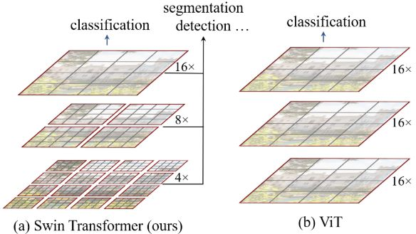
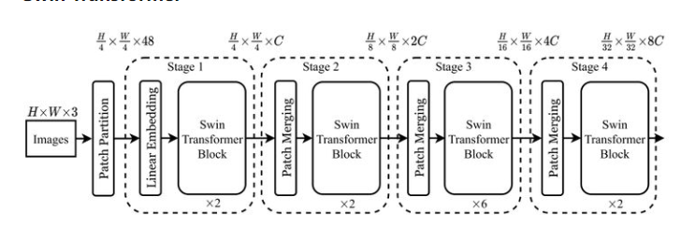

Slide 23
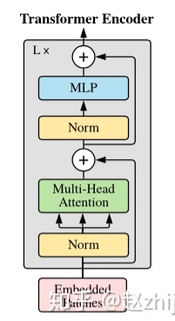
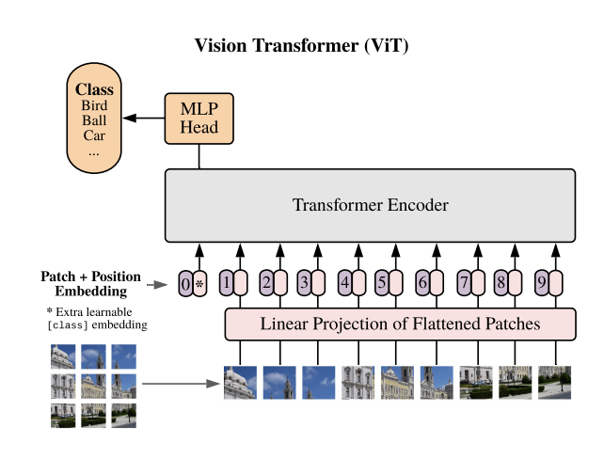

Slide 24
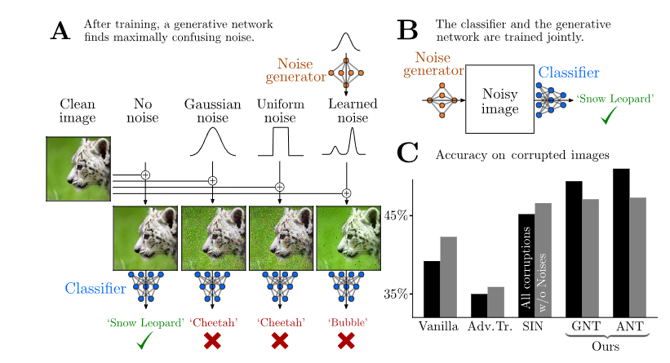

Slide 25
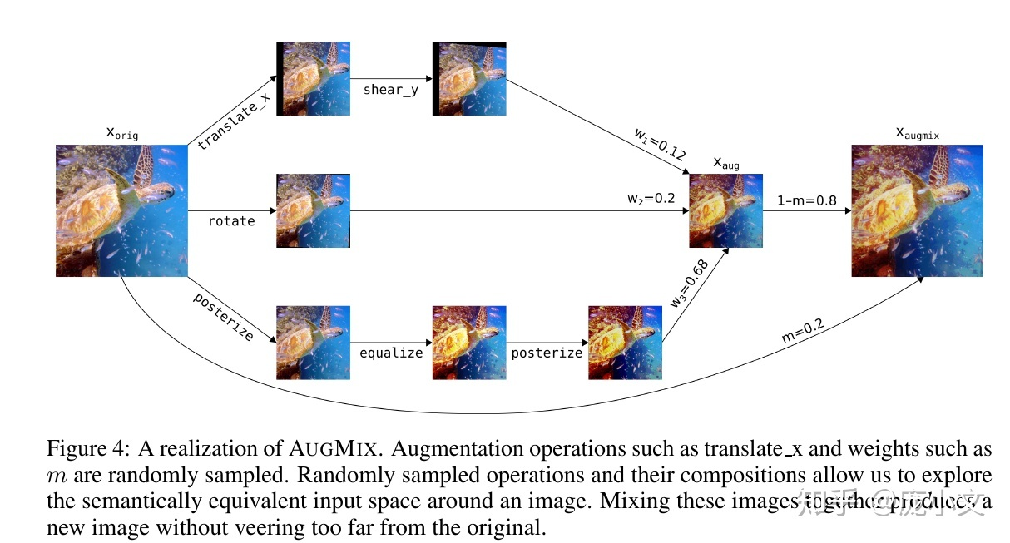

Slide 26
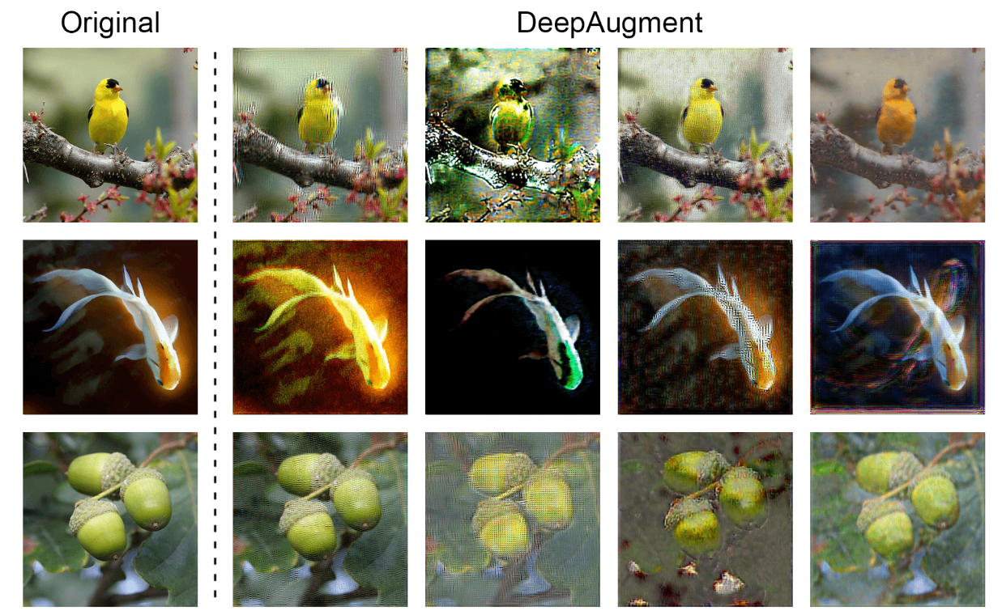

Slide 27
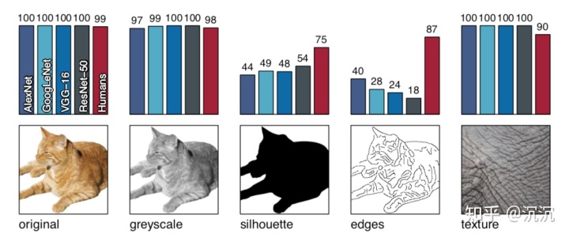

Slide 28
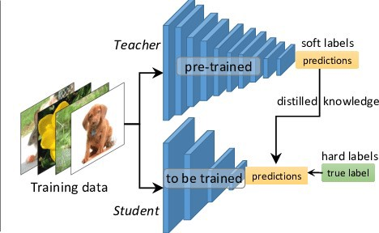

Slide 29
碩論預期方向
1.Slot 影片辨識
a)辨識流程與UI系統建置
b)各項目模型交叉測試
①找出最佳模型組合
②提出新的模型架構
2.分群特徵分析
①)最佳化Slot Symbol特徵
②)最佳化ImageNet特徵
3.Game State
NTUST GAMELab

